Slide 1

Introduction to Cloud Computing
Introduction, Roots of Cloud Computing: From Mainframes to Cloud, Benefits of Cloud Computing SOA, Web services, Role of Networks in
Cloud Computing: Cloud types and service models, Primary Cloud
Service models, Cloud Services brokerage, Primary cloud deployment
models, cloud computing reference model, The greenfield and brownfield
deployment options, SLAs.

Slide 2
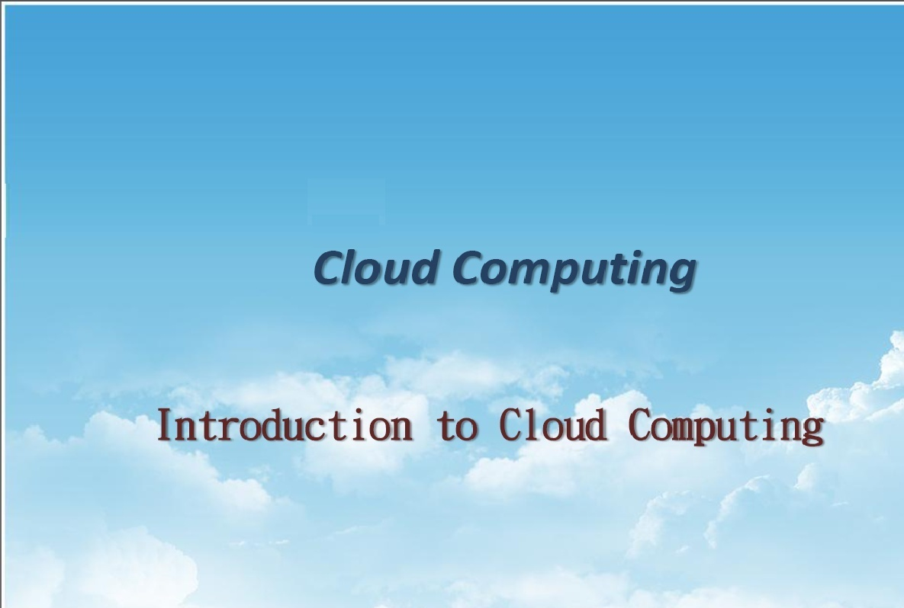
UNIT - I
Notes:
2

Slide 3
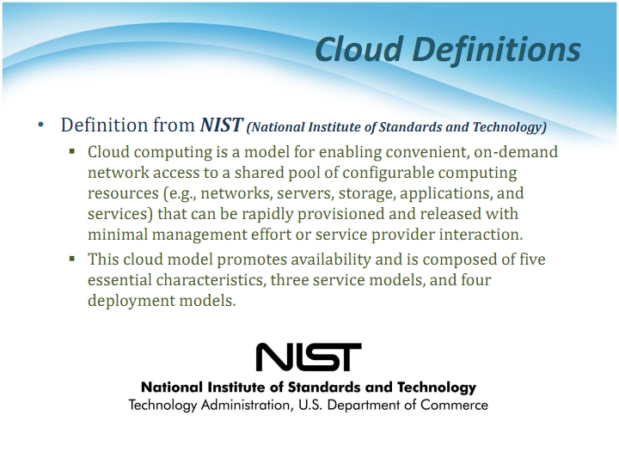
Resource provisioning with minimal service provider interaction.
Notes:
3

Slide 4
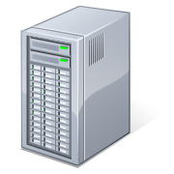
4
What is Cloud Computing
Shared pool of configurable computing resources
On-demand network access
Provisioned by the Service Provider
Applications
Services
Computer Network
Storage (Database)
SERvers
Adopted from: Effectively and Securely Using the Cloud Computing Paradigm by peter Mell, Tim Grance
Notes:
4

Slide 5
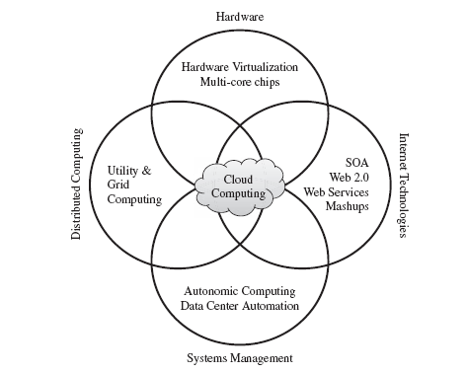
ROOTS OF CLOUD COMPUTING
From Mainframes to Clouds
SOA, Web Services, Web 2.0, and Mashups
Grid Computing
Utility Computing
Virtual Appliances and the Open Virtualization Format
Autonomic Computing

Slide 6
Service Oriented Computing
Service orientation is the core reference model for cloud computing systems.
A service is an abstraction representing a self-describing and platform-agnostic component that can perform any function—anything from a simple function to a complex business process.
A service is supposed to be loosely coupled, reusable, programming language independent, and location transparent.
Services are composed and aggregated into a service-oriented architecture (SOA) , which is a logical way of organizing software systems to provide end users or other entities distributed over the network with services through published and discoverable interfaces
Service-oriented computing introduces and diffuses two important concepts, which are also fundamental to cloud computing: quality of service (QoS) and Software-as-a-Service (SaaS)
One of the most popular expressions of service orientation is represented by Web Services (WS). These introduce the concepts of SOC into the World Wide Web, by making it consumable by applications and not only humans.

Slide 7
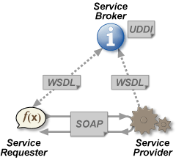
What is a Web Service?
W3C
Web services are web application components.
SOAP is XML based protocol for accessing web services and exchanging info.
WSDL(Web Service Description Language) is XML based language for describing web services.
UDDI(Universal Description Discovery and Integration) is a directory service where companies can search for Web services.
UDDI communicates via SOAP
Notes:
SOAP – Simple Object Access Protocol
WSDL- Web Service Description Language
UDDI - Universal Description, Discovery and Integration (UDDI)

Slide 8
What is a Web Service?
Web Services can convert your application into a Web-application, which can publish its function or message to the rest of the world. Web services allow different applications from different sources to communicate with each other without time-consuming custom coding, and because all communication is in XML, Web services are not tied to any one operating system or programming language
For example , Java can talk with Perl, Windows applications can talk with UNIX applications . Unlike traditional client/server models, such as a Web server/Web page system, Web services do not provide the user with a GUI. Web services instead share business logic, data and processes through a programmatic interface across a network.

Slide 9
Utility Computing and Grid Computing
Utility computing is the packaging of computing resources, such as computation, storage and services, as a metered service. This model has the advantage of a low or no initial cost to acquire computer resources; instead, computational resources are essentially rented.
This repackaging of computing services became the foundation of the shift to "on demand" computing.
Grid Computing is Grid computing enables aggregation of distributed resources and transparently access to them.
Most production grids such as TeraGrid and EGEE seek to share compute and storage resources distributed across different
administrative domains, with their main focus being speeding up a broad range of scientific applications, such as climate modeling, drug design, and protein analysis.
Notes:
9

Slide 10
 | Cloud Computing | Grid Computing
1. | Cloud computing is a Client-server computing architecture. | While it is a Distributed computing architecture.
2. | Cloud computing is a centralized executive. | While grid computing is a decentralized executive.
3. | In cloud computing, resources are used in centralized pattern. | While in grid computing, resources are used in collaborative pattern.
4. | It is more flexible than grid computing. | While it is less flexible than cloud computing.
5. | In cloud computing, the users pay for the use. | While in grid computing, the users do not pay for use.
6. | Cloud computing is a high accessible service. | While grid computing is a low accessible service.
7. | It is highly scalable as compared to grid computing. | While grid computing is low scalable in comparison to cloud computing.
8. | It can be accessed through standard web protocols. | While it is accessible through grid middleware.
9. | Cloud computing is based on service-oriented. | Grid computing is based on application-oriented.
10. | Cloud computing uses service like IAAS, PAAS, SAAS. | Grid computing uses service like distributed computing, distributed pervasive, distributed information.

Slide 11
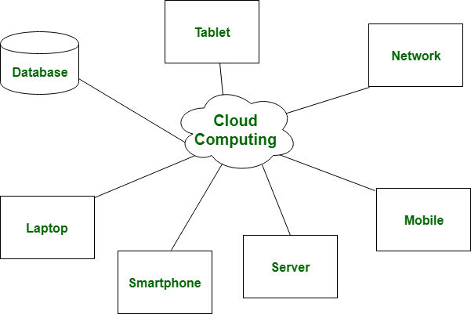
Cloud Computing: Cloud Computing is a Client-server computing architecture. In cloud computing, resources are used in centralized pattern and cloud computing is a high accessible service. It is a pay and use business means, in cloud computing, the users pay for the use

Slide 12
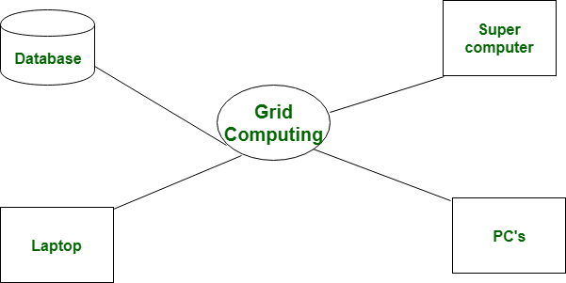
Grid Computing: Grid Computing is a Distributed computing architecture. In grid computing, resources are used in collaborative pattern, and also in grid computing, the users do not pay for use.

Slide 13
Essential Characteristics
Self-Service
Per-Usage Metering and Billing
Elasticity
Customization
Notes:
13

Slide 14
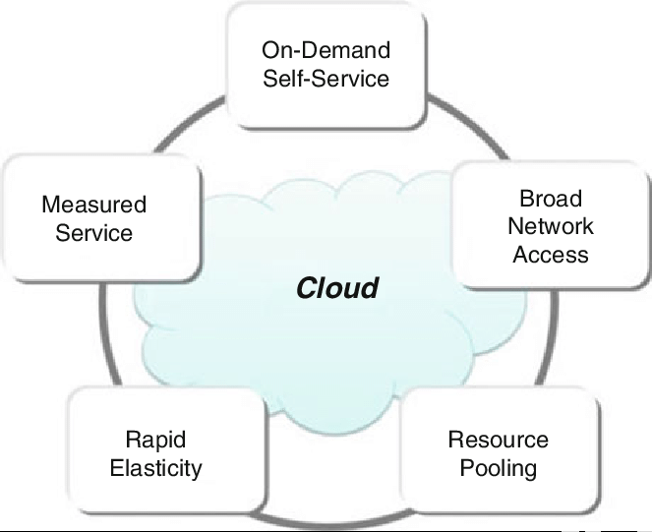

Slide 15
On-demand self-services: The Cloud computing services does not require any human administrators, user themselves are able to provision, monitor and manage computing resources as needed.
Broad network access: The Computing services are generally provided over standard networks and heterogeneous devices.
Rapid elasticity: The Computing services should have IT resources that are able to scale out and in quickly and on as needed basis. Whenever the user require services it is provided to him and it is scale out as soon as its requirement gets over.

Slide 16
Resource pooling: The IT resource (e.g., networks, servers, storage, applications, and services) present are shared across multiple applications and occupant in an uncommitted manner. Multiple clients are provided service from a same physical resource.
Measured service: The resource utilization is tracked for each application and occupant, it will provide both the user and the resource provider with an account of what has been used. This is done for various reasons like monitoring billing and effective use of resource.
Multi-tenancy: Cloud computing providers can support multiple tenants (users or organizations) on a single set of shared resources.

Slide 17
Virtualization: Cloud computing providers use virtualization technology to abstract underlying hardware resources and present them as logical resources to users.
Resilient computing: Cloud computing services are typically designed with redundancy and fault tolerance in mind, which ensures high availability and reliability.
Flexible pricing models: Cloud providers offer a variety of pricing models, including pay-per-use, subscription-based, and spot pricing, allowing users to choose the option that best suits their needs.

Slide 18
Security: Cloud providers invest heavily in security measures to protect their users’ data and ensure the privacy of sensitive information.
Automation: Cloud computing services are often highly automated, allowing users to deploy and manage resources with minimal manual intervention.
Sustainability: Cloud providers are increasingly focused on sustainable practices, such as energy-efficient data centers and the use of renewable energy sources, to reduce their environmental impact.

Slide 19
Cloud Characteristics
On demand self service
- made available in couple of minutes.
- without service provider interaction(in SaaS) ex. email
Broad Network Access
- Over network accessed through thin or thick client platforms (mobile phones, laptops,PDAs)
- Private cloud, public cloud and Hybrid cloud
Notes:
19

Slide 20
Rapid Elasticity
Provisioned or released as per on – demand.
Make sure of exact capacity , an application demands.
Scalability
Measured Service
Monitored resource usage - Pay per use.
Reserved / Spot / On demand instances
Optimized resources( In AWS, c1. small, medium , large, m2, g2)
Notes:
20

Slide 21
Customization
Multitenancy
Single instance of resource giving access to multiple organization (tenants).
Virtualized access.
In the case of infrastructure services, customization means allowing users to deploy specialized virtual appliances and to be given privileged (root) access to the virtual servers. Other service classes (PaaS and SaaS) offer less flexibility and are not suitable for general-purpose computing [5], but still are expected to provide a certain level of customization.
Virtualization uses software that simulates hardware functionality to create a virtual system. This practice allows IT organizations to operate multiple operating systems, more than one virtual system and various applications on a single server. The benefits of virtualization include greater efficiencies and economies of scale.
Notes:
21

Slide 22
Cloud Characteristics -Advanced Features
Virtualization Support.
Self-Service, On-Demand Resource Provisioning
Multiple Backend Hypervisors.
(A hypervisor, also known as a virtual machine monitor or VMM, is software that creates and runs virtual machines (VMs).)
Storage Virtualization.
Interface to Public Clouds.
Virtual Networking.
Dynamic Resource Allocation.
Virtual Clusters.
Reservation and Negotiation Mechanism.
High Availability and Data Recovery.

Slide 23
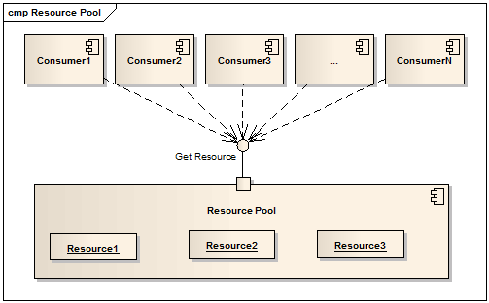
Resource Pooling
Resources are pooled to serve multiple consumers using a multitenant model.
Dynamically assigned and reassigned as per consumer’s demand.
(Location Independence)
Able to specify location at a higher level of abstraction(Country, state or datacenter) like in AWS. (US East, west, oregano)
Notes:
23

Slide 24
Benefits of Cloud Computing(Vs Traditional Computing)
No up-front commitments, Reduced Cost
On-demand access
Nice pricing
Simplified application acceleration and scalability
Efficient resource allocation
Energy efficiency
Seamless creation and use of third-party services
Notes:
24

Slide 25
1.CloudComputing : Cloud Computing, as name suggests, is collective combination of configurable system resources and advanced service that can be delivered quickly using internet. It simply provides lower power expenses, no capital costs, no redundancy, lower employee costs, increased collaboration, etc. It makes us more efficient, more secure, and provide greater flexibility.
2.TraditionalComputing : Traditional Computing, as name suggests, is a possess of using physical data centers for storing digital assets and running complete networking system for daily operations. In this, access to data, or software, or storage by users is limited to device or official network they are connected with. In this computing, user can have access to data only on system in which data is stored.

Slide 26
CloudComputing It refers to delivery of different services such as data and programs through internet on different servers. | TraditionalComputing It refers to delivery of different services on local server.
It takes place on third-party servers that is hosted by third-party hosting companies. | It takes place on physical hard drives and website servers.
It is ability to access data anywhere at any time by user. | User can access data only on system in which data is stored.
It is more cost effective as compared to tradition computing as operation and maintenance of server is shared among several parties that in turn reduce cost of public services. | It is less cost effective as compared to cloud computing because one has to buy expensive equipment’s to operate and maintain server.

Slide 27
It is more user-friendly as compared to traditional computing because user can have access to data anytime anywhere using internet. | It is less user-friendly as compared to cloud computing because data cannot be accessed anywhere and if user has to access data in another system, then he need to save it in external storage medium.
It requires fast, reliable and stable internet connection to access information anywhere at any time. | It does not require any internet connection to access data or information.
It provides more storage space and servers as well as more computing power so that applications and software run must faster and effectively. | It provides less storage as compared to cloud computing.
It also provides scalability and elasticity i.e., one can increase or decrease storage capacity, server resources, etc., according to business needs. | It does not provide any scalability and elasticity.

Slide 28
Cloud service is served by provider’s support team. | It requires own team to maintain and monitor system that will need a lot of time and efforts.
Software is offered as an on-demand service (SaaS) that can be accessed through subscription service. | Software in purchased individually for every user and requires to be updated periodically.

Slide 29
Cloud Service Offerings
Cloud service offerings are classified into three models which are
SaaS (Software as a Service)
PaaS (Platform as a Service)
IaaS (Infrastructure as a Service)
Notes:
29

Slide 30
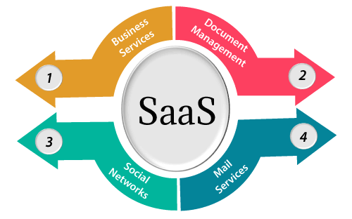

Slide 31
SaaS is also known as "On-Demand Software". It is a software distribution model in which services are hosted by a cloud service provider. These services are available to end-users over the internet so, the end-users do not need to install any software on their devices to access these services.
There are the following services provided by SaaS providers -
Business Services - SaaS Provider provides various business services to start-up the business. The SaaS business services include ERP (Enterprise Resource Planning), CRM (Customer Relationship Management), billing, and sales.
Document Management - SaaS document management is a software application offered by a third party (SaaS providers) to create, manage, and track electronic documents.
Example: Slack, Samepage, Box, and Zoho Forms.
Social Networks - As we all know, social networking sites are used by the general public, so social networking service providers use SaaS for their convenience and handle the general public's information.
Mail Services - To handle the unpredictable number of users and load on e-mail services, many e-mail providers offering their services using SaaS.

Slide 32
Advantages of SaaS cloud computing layer
1) SaaS is easy to buy
SaaS pricing is based on a monthly fee or annual fee subscription, so it allows organizations to access business functionality at a low cost, which is less than licensed applications.
Unlike traditional software, which is sold as a licensed based with an up-front cost (and often an optional ongoing support fee), SaaS providers are generally pricing the applications using a subscription fee, most commonly a monthly or annually fee.
2. One to Many
SaaS services are offered as a one-to-many model means a single instance of the application is shared by multiple users.
3. Less hardware required for SaaS
The software is hosted remotely, so organizations do not need to invest in additional hardware.
4. Low maintenance required for SaaS
Software as a service removes the need for installation, set-up, and daily maintenance for the organizations. The initial set-up cost for SaaS is typically less than the enterprise software. SaaS vendors are pricing their applications based on some usage parameters, such as a number of users using the application. So SaaS does easy to monitor and automatic updates.

Slide 33
5. No special software or hardware versions required
All users will have the same version of the software and typically access it through the web browser. SaaS reduces IT support costs by outsourcing hardware and software maintenance and support to the IaaS provider.
6. Multidevice support
SaaS services can be accessed from any device such as desktops, laptops, tablets, phones, and thin clients.
7. API Integration
SaaS services easily integrate with other software or services through standard APIs.
8. No client-side installation
SaaS services are accessed directly from the service provider using the internet connection, so do not need to require any software installation.

Slide 34
Disadvantages of SaaS cloud computing layer
1) Security
Actually, data is stored in the cloud, so security may be an issue for some users. However, cloud computing is not more secure than in-house deployment.
2) Latency issue
Since data and applications are stored in the cloud at a variable distance from the end-user, there is a possibility that there may be greater latency when interacting with the application compared to local deployment. Therefore, the SaaS model is not suitable for applications whose demand response time is in milliseconds.
3) Total Dependency on Internet
Without an internet connection, most SaaS applications are not usable.
4) Switching between SaaS vendors is difficult
Switching SaaS vendors involves the difficult and slow task of transferring the very large data files over the internet and then converting and importing them into another SaaS also.

Slide 35
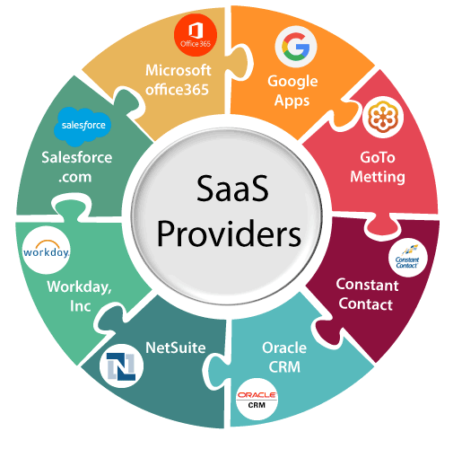

Slide 36
SaaS
Common SaaS Use-Case: Replaces traditional on-device software
In this the provider’s application are running on the cloud infrastructure.
The application are accessible from various client devices through a thin client interface such as a web browser.
The consumer does not manage or control the underlying cloud infrastructure including network, servers, operating systems, storage, or even individual application capabilities, with the possible exception of limited user-specific application configuration settings.
Examples : Workday(ERP for HR), Concur(expense mgmt), Citrix GoToMeeting/Cisco WebEx(online meetings and video conferencing)
Notes:
36

Slide 37
Characteristics
Here are the characteristics of SaaS service model:
SaaS makes the software available over the Internet.
The software applications are maintained by the vendor.
The license to the software may be subscription based or usage based. And it is billed on recurring basis.
SaaS applications are cost-effective since they do not require any maintenance at end user side.
They are available on demand.
They can be scaled up or down on demand.
They are automatically upgraded and updated.
SaaS offers shared data model. Therefore, multiple users can share single instance of infrastructure. It is not required to hard code the functionality for individual users.
All users run the same version of the software.

Slide 38
Benefits of SaaS
1.Reduced time to benefit
.
2. Lower Cost
3. New releases (upgrades)
4.Easy to use
5. Any time & any where access
Notes:
38

Slide 39
Challenges
Data Availability
Governance & billing Mgmt
Need of good connectivity
Synchronization of client & vendor migration(vendor lock-in)
Notes:
39

Slide 40
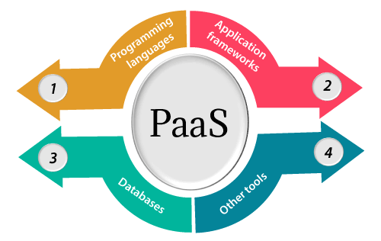
Platform-as-a-Service offers the runtime environment for applications. It also offers development and deployment tools required to develop applications. PaaS has a feature of point-and-click tools that enables non-developers to create web applications.
App Engine of Google and Force.com are examples of PaaS offering vendors. Developer may log on to these websites and use the built-in API to create web-based applications.

Slide 41
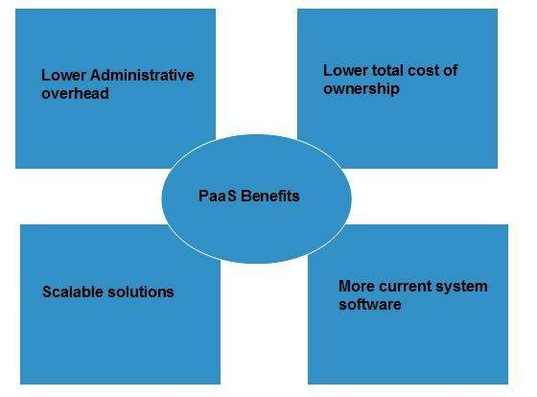
Benefits
Following are the benefits of PaaS model:

Slide 42
Lower administrative overhead
Customer need not bother about the administration because it is the responsibility of cloud provider.
Lower total cost of ownership
Customer need not purchase expensive hardware, servers, power, and data storage.
Scalable solutions
It is very easy to scale the resources up or down automatically, based on their demand.
More current system software
It is the responsibility of the cloud provider to maintain software versions and patch installations.

Slide 43
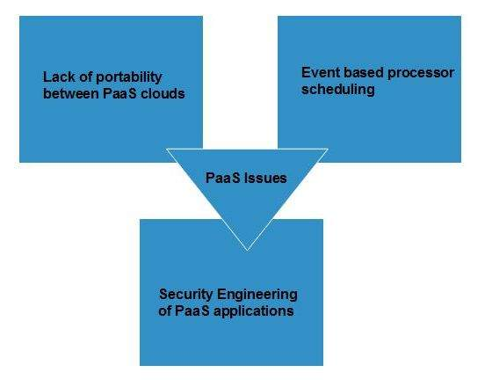
Issues
Like SaaS, PaaS also places significant burdens on customer's browsers to maintain reliable and secure connections to the provider’s systems. Therefore, PaaS shares many of the issues of SaaS. However, there are some specific issues associated with PaaS as shown in the following diagram:

Slide 44
Lack of portability between PaaS clouds
Although standard languages are used, yet the implementations of platform services may vary. For example, file, queue, or hash table interfaces of one platform may differ from another, making it difficult to transfer the workloads from one platform to another.
Event based processor scheduling
The PaaS applications are event-oriented which poses resource constraints on applications, i.e., they have to answer a request in a given interval of time.
Security engineering of PaaS applications
Since PaaS applications are dependent on network, they must explicitly use cryptography and manage security exposures.

Slide 45
Characteristics
Here are the characteristics of PaaS service model:
PaaS offers browser based development environment. It allows the developer to create database and edit the application code either via Application Programming Interface or point-and-click tools.
PaaS provides built-in security, scalability, and web service interfaces.
PaaS provides built-in tools for defining workflow, approval processes, and business rules.
It is easy to integrate PaaS with other applications on the same platform.
PaaS also provides web services interfaces that allow us to connect the applications outside the platform.

Slide 46
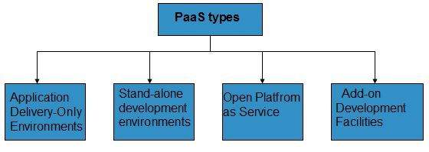
PaaS Types
Based on the functions, PaaS can be classified into four types as shown in the following diagram:

Slide 47
Stand-alone development environments
The stand-alone PaaS works as an independent entity for a specific function. It does not include licensing or technical dependencies on specific SaaS applications.
Application delivery-only environments
The application delivery PaaS includes on-demand scaling and application security.
Open platform as a service
Open PaaS offers an open source software that helps a PaaS provider to run applications.
Add-on development facilities
The add-on PaaS allows to customize the existing SaaS platform.

Slide 48
PaaS(Platform as a Service)
Web appl envi, os instances, database, middlewares.
Used to develop cloud – ready application.
Providers PL& Tools:The capability provided to the consumer is to deploy consumer-created or acquired applications (created using programming languages and tools supported by the provider) on the cloud infrastructure.
Common PaaS Use-Case: Increases developer productivity and utilization rates
Only deploy code : The consumer does not manage or control the underlying cloud infrastructure, including network, servers, operating systems, or storage, but has control over the deployed applications and possibly application hosting environment configurations.
Google App Engine, Microsoft Azure, and Force.com are foremost examples of platform as a service.
Notes:
48

Slide 49
Benefits of PaaS
Enables developer to focus on appl code & business logic
Natural fit for development, testing & production environments
Take Less time
Scalable without delay
Eliminate the complexities of h/w & s/w dependencies
Notes:
49

Slide 50
Challenges of PaaS
Risk of vendor lock-in
Interoperability & connectivity with existing on-premises appl
Rely on third party performance & scalability SLAs
Potential security risk & loss of control over the data
GAE, Force.com, hureko, cloud foundry
Notes:
50

Slide 51
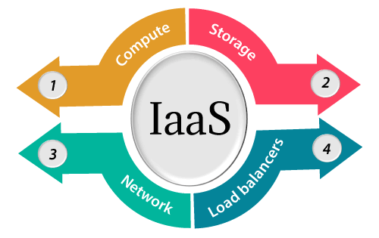
Iaas is also known as Hardware as a Service (HaaS). It is one of the layers of the cloud computing platform. It allows customers to outsource their IT infrastructures such as servers, networking, processing, storage, virtual machines, and other resources. Customers access these resources on the Internet using a pay-as-per use model.
In traditional hosting services, IT infrastructure was rented out for a specific period of time, with pre-determined hardware configuration. The client paid for the configuration and time, regardless of the actual use. With the help of the IaaS cloud computing platform layer, clients can dynamically scale the configuration to meet changing requirements and are billed only for the services actually used.

Slide 52
IaaS cloud computing platform layer eliminates the need for every organization to maintain the IT infrastructure.
IaaS is offered in three models: public, private, and hybrid cloud. The private cloud implies that the infrastructure resides at the customer-premise. In the case of public cloud, it is located at the cloud computing platform vendor's data center, and the hybrid cloud is a combination of the two in which the customer selects the best of both public cloud or private cloud.
IaaS provider provides the following services -
Compute: Computing as a Service includes virtual central processing units and virtual main memory for the Vms that is provisioned to the end- users.
Storage: IaaS provider provides back-end storage for storing files.
Network: Network as a Service (NaaS) provides networking components such as routers, switches, and bridges for the Vms.
Load balancers: It provides load balancing capability at the infrastructure layer.

Slide 53
Advantages of IaaS cloud computing layer
There are the following advantages of IaaS computing layer -
1. Shared infrastructure
IaaS allows multiple users to share the same physical infrastructure.
2. Web access to the resources
Iaas allows IT users to access resources over the internet.
3. Pay-as-per-use model
IaaS providers provide services based on the pay-as-per-use basis. The users are required to pay for what they have used.
4. Focus on the core business
IaaS providers focus on the organization's core business rather than on IT infrastructure.
5. On-demand scalability
On-demand scalability is one of the biggest advantages of IaaS. Using IaaS, users do not worry about to upgrade software and troubleshoot the issues related to hardware components.

Slide 54
Disadvantages of IaaS cloud computing layer
1. Security
Security is one of the biggest issues in IaaS. Most of the IaaS providers are not able to provide 100% security.
2. Maintenance & Upgrade
Although IaaS service providers maintain the software, but they do not upgrade the software for some organizations.
3. Interoperability issues
It is difficult to migrate VM from one IaaS provider to the other, so the customers might face problem related to vendor lock-in.

Slide 55
Some important point about IaaS cloud computing layer
IaaS cloud computing platform cannot replace the traditional hosting method, but it provides more than that, and each resource which are used are predictable as per the usage.
IaaS cloud computing platform may not eliminate the need for an in-house IT department. It will be needed to monitor or control the IaaS setup. IT salary expenditure might not reduce significantly, but other IT expenses can be reduced.
Breakdowns at the IaaS cloud computing platform vendor's can bring your business to the halt stage. Assess the IaaS cloud computing platform vendor's stability and finances. Make sure that SLAs (i.e., Service Level Agreement) provide backups for data, hardware, network, and application failures. Image portability and third-party support is a plus point.
The IaaS cloud computing platform vendor can get access to your sensitive data. So, engage with credible companies or organizations. Study their security policies and precautions.

Slide 56
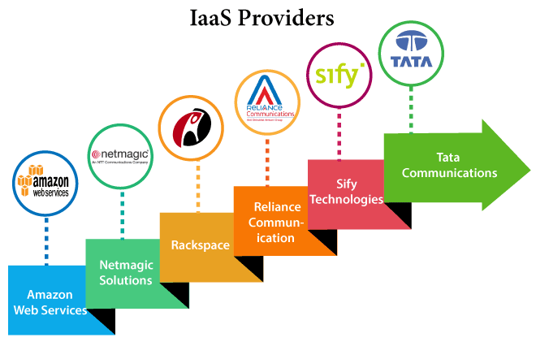

Slide 57
IaaS Vendor | Iaas Solution | Details
Amazon Web Services | Elastic, Elastic Compute Cloud (EC2) MapReduce, Route 53, Virtual Private Cloud, etc. | The cloud computing platform pioneer, Amazon offers auto scaling, cloud monitoring, and load balancing features as part of its portfolio.
Netmagic Solutions | Netmagic IaaS Cloud | Netmagic runs from data centers in Mumbai, Chennai, and Bangalore, and a virtual data center in the United States. Plans are underway to extend services to West Asia.
Rackspace | Cloud servers, cloud files, cloud sites, etc. | The cloud computing platform vendor focuses primarily on enterprise-level hosting services.
Reliance Communications | Reliance Internet Data Center | RIDC supports both traditional hosting and cloud services, with data centers in Mumbai, Bangalore, Hyderabad, and Chennai. The cloud services offered by RIDC include IaaS and SaaS.
Sify Technologies | Sify IaaS | Sify's cloud computing platform is powered by HP's converged infrastructure. The vendor offers all three types of cloud services: IaaS, PaaS, and SaaS.
Tata Communications | InstaCompute | InstaCompute is Tata Communications' IaaS offering. InstaCompute data centers are located in Hyderabad and Singapore, with operations in both countries.

Slide 58
IaaS
The capability provided to the consumer is to provision processing, servers, storage, networks, and other fundamental computing resources where the consumer is able to deploy and run arbitrary software, which can include operating systems and applications.
Common IaaS Use-Case: Extends current data center infrastructure for temporary workloads (e.g. increased Christmas holiday site traffic)
The consumer does not manage or control the underlying cloud infrastructure but has control over operating systems, deployed applications, and possibly limited control of select networking components for example host firewalls.
Examples :Amazon Web Services (AWS), Cisco Metapod, Microsoft Azure, Google Compute Engine (GCE), Joyent
Notes:
58

Slide 59
Benefits of IaaS
Effective infrastructure utilization
Highly automated resulting in faster provisioning of resources
Easily meet the changing demand for consumption
Reduced cost due to less h/w resources
, space, power consumption.
Notes:
59

Slide 60
Challenges of IaaS
Migration of data
Need of good connectivity
Vendor reliability & security risk
Difficult to make a gateway for integrating in-premise , firewall protected appl with appl on public cloud.
Ex. AWS rackspace cloud hosting
Notes:
60

Slide 61
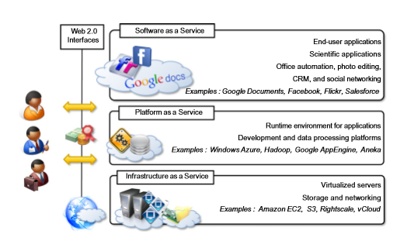
Cloud Computing Reference Model

Slide 62
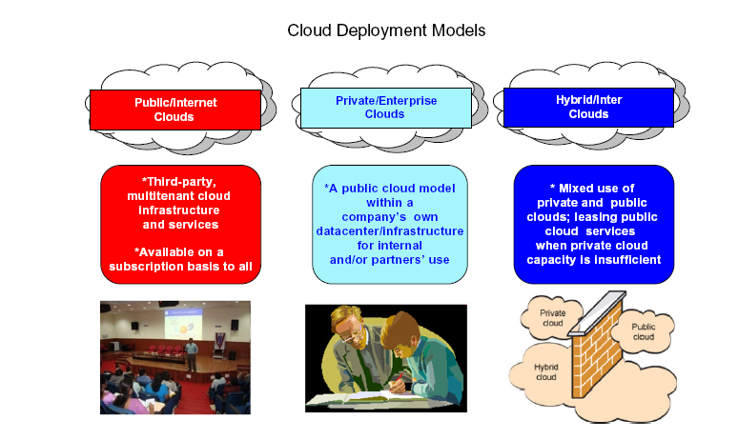
Deployment Models(Organizational Scenario)
An agency can deploy cloud computing in several different ways depending upon many factors, such as:
Where the cloud services are hosted
Security requirements
Desire to share cloud services
The ability to manage some or all of the services
Customization capabilities
There are four common deployment models for cloud services loosely determined by who has access to the cloud services: Public Cloud, Private Cloud, Community Cloud, and Hybrid Cloud.
Notes:
62

Slide 63
Deployment Models
The cloud deployment model identifies the specific type of cloud environment based on ownership, scale, and access, as well as the cloud’s nature and purpose. The location of the servers you’re utilizing and who controls them are defined by a cloud deployment model. It specifies how your cloud infrastructure will look, what you can change, and whether you will be given services or will have to create everything yourself. Relationships between the infrastructure and your users are also defined by cloud deployment types.
Different types of cloud computing deployment models are:
Public cloud
Private cloud
Hybrid cloud
Community cloud
Multi-cloud

Slide 64
Public Cloud
The public cloud makes it possible for anybody to access systems and services. The public cloud may be less secure as it is open to everyone. The public cloud is one in which cloud infrastructure services are provided over the internet to the general people or major industry groups.
The infrastructure in this cloud model is owned by the entity that delivers the cloud services, not by the consumer.
It is a type of cloud hosting that allows customers and users to easily access systems and services.
This form of cloud computing is an excellent example of cloud hosting, in which service providers supply services to a variety of customers.
In this arrangement, storage backup and retrieval services are given for free, as a subscription, or on a per-user basis. Example: Google App Engine etc.

Slide 65
Advantages of Public Cloud Model:
Minimal Investment: Because it is a pay-per-use service, there is no substantial upfront fee, making it excellent for enterprises that require immediate access to resources.
No setup cost: The entire infrastructure is fully subsidized by the cloud service providers, thus there is no need to set up any hardware.
Infrastructure Management is not required: Using the public cloud does not necessitate infrastructure management.
No maintenance: The maintenance work is done by the service provider (Not users).
Dynamic Scalability: To fulfill your company’s needs, on-demand resources are accessible.
Disadvantages of Public Cloud Model:
Less secure: Public cloud is less secure as resources are public so there is no guarantee of high-level security.
Low customization: It is accessed by many public so it can’t be customized according to personal requirements.

Slide 66
Private Cloud
The private cloud deployment model is the exact opposite of the public cloud deployment model.
It’s a one-on-one environment for a single user (customer). There is no need to share your hardware with anyone else.
The distinction between private and public clouds is in how you handle all of the hardware.
It is also called the “internal cloud” & it refers to the ability to access systems and services within a given border or organization.
The cloud platform is implemented in a cloud-based secure environment that is protected by powerful firewalls and under the supervision of an organization’s IT department.
The private cloud gives greater flexibility of control over cloud resources.

Slide 67
Advantages of Private Cloud Model:
Better Control: You are the sole owner of the property. You gain complete command over service integration, IT operations, policies, and user behavior.
Data Security and Privacy: It’s suitable for storing corporate information to which only authorized staff have access. By segmenting resources within the same infrastructure, improved access and security can be achieved.
Supports Legacy Systems: This approach is designed to work with legacy systems that are unable to access the public cloud.
Customization: Unlike a public cloud deployment, a private cloud allows a company to tailor its solution to meet its specific needs.
Disadvantages of Private Cloud Model:
Less scalable: Private clouds are scaled within a certain range as there is less number of clients.
Costly: Private clouds are more costly as they provide personalized facilities.

Slide 68
Hybrid Cloud
By bridging the public and private worlds with a layer of proprietary software, hybrid cloud computing gives the best of both worlds.
With a hybrid solution, you may host the app in a safe environment while taking advantage of the public cloud’s cost savings.
Organizations can move data and applications between different clouds using a combination of two or more cloud deployment methods, depending on their needs.
Advantages of Hybrid Cloud Model:
Flexibility and control: Businesses with more flexibility can design personalized solutions that meet their particular needs.
Cost: Because public clouds provide scalability, you’ll only be responsible for paying for the extra capacity if you require it.
Security: Because data is properly separated, the chances of data theft by attackers are considerably reduced.

Slide 69
Disadvantages of Hybrid Cloud Model:
Difficult to manage: Hybrid clouds are difficult to manage as it is a combination of both public and private cloud. So, it is complex.
Slow data transmission: Data transmission in the hybrid cloud takes place through the public cloud so latency occurs.

Slide 70
Community Cloud
It allows systems and services to be accessible by a group of organizations.
It is a distributed system that is created by integrating the services of different clouds to address the specific needs of a community, industry, or business.
The infrastructure of the community could be shared between the organization which has shared concerns or tasks. It is generally managed by a third party or by the combination of one or more organizations in the community.
Advantages of Community Cloud Model:
Cost Effective: It is cost-effective because the cloud is shared by multiple organizations or communities.
Security: Community cloud provides better security.
Shared resources: It allows you to share resources, infrastructure, etc. with multiple organizations.
Collaboration and data sharing: It is suitable for both collaboration and data sharing.

Slide 71
Disadvantages of Community Cloud Model:
Limited Scalability: Community cloud is relatively less scalable as many organizations share the same resources according to their collaborative interests.
Rigid in customization: As the data and resources are shared among different organizations according to their mutual interests if an organization wants some changes according to their needs they cannot do so because it will have an impact on other organizations.

Slide 72
Multi-cloud
We’re talking about employing multiple cloud providers at the same time under this paradigm, as the name implies. I
t’s similar to the hybrid cloud deployment approach, which combines public and private cloud resources.
Instead of merging private and public clouds, multi-cloud uses many public clouds.
Although public cloud providers provide numerous tools to improve the reliability of their services, mishaps still occur. It’s quite rare that two distinct clouds would have an incident at the same moment. As a result, multi-cloud deployment improves the high availability of your services even more.
Advantages of a Multi-Cloud Model:
You can mix and match the best features of each cloud provider’s services to suit the demands of your apps, workloads, and business by choosing different cloud providers.
Reduced Latency: To reduce latency and improve user experience, you can choose cloud regions and zones that are close to your clients.
High availability of service: It’s quite rare that two distinct clouds would have an incident at the same moment. So, the multi-cloud deployment improves the high availability of your services.

Slide 73
Disadvantages of Multi-Cloud Model:
Complex: The combination of many clouds makes the system complex and bottlenecks may occur.
Security issue: Due to the complex structure, there may be loopholes to which a hacker can take advantage hence, makes the data insecure.

Slide 74
Public cloud
Available to the general public and is owned by a third party cloud service provider (CSP).
An agency dynamically provisions computing resources over the Internet from a CSP who shares its resources with other organizations.
The CSP bills the agency for its share of resources used similar to that of an electric utility.
Cost effective deployment model for agencies as it gives them the flexibility to procure only the computing resources they need
Services are delivered with consistent availability, resiliency, security, and manageability.
Nevertheless, to benefit from a public cloud, an agency must accept reduced control and monitoring over the provider’s governance and security.
Notes:
74

Slide 75
Private cloud
Operated solely for a single organization or agency: the CSP dedicates specific cloud services to that agency and no other clients.
The agency specifies, architects, and controls a pool of computing resources that the CSP delivers as a standardized set of services.
A common reason for agencies to procure private clouds is their ability to enforce their data security standards and controls.
An agency will typically host a private cloud on-premises, connect to it through private network links, and only share its resources within the agency.
Because resources are not pooled across multiple unaffiliated organizations, an agency will pay for all of the cloud's capacity.
Nevertheless, the agency's Chief Information Officer (CIO) can provide these resources as services on-demand to organizations and programs within the agency and charge them accordingly.
Notes:
75

Slide 76
Community cloud
Procured jointly by several agencies or programs that share specific needs such as security, compliance, or jurisdiction considerations.
The agencies or CSP may manage the community cloud and it may exist on-premises or off-premises.
Enables agencies with common set of requirements to combine assets and share computing resources, data, and capabilities.
By eliminating the duplication of similar systems, agencies can save money and more efficiently allocate their scarce resources.
Procuring a community cloud is also a way that an agency can advance the Federal IT Shared Service Strategy.
Notes:
76

Slide 77
Hybrid cloud
Comprises two or more clouds (private, community, or public) with a mix of both internally and externally hosted services.
Agencies will likely not limit themselves to one cloud deployment but will rather incorporate different and overlapping cloud services to meet their unique requirements.
Hybrid deployment models are complex and require careful planning to execute and manage especially when communication between two different cloud deployments is necessary.
Notes:
77

Slide 78
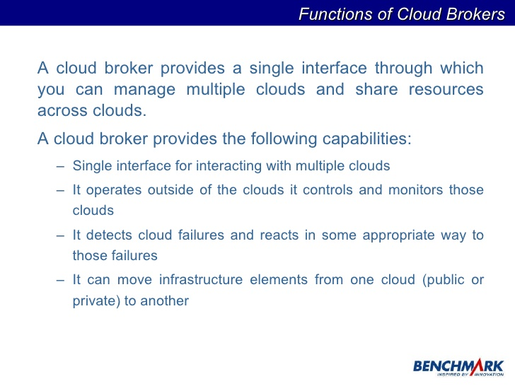
Cloud Service Brokerage (CSB)
CSB system plays a brokering role between CSP and CSC.
Upon receiving requirements of CSC, CSB validates service requirements to establish service selection plan and selects optimum service through service assignment negotiation & selection process.
The selected service is assigned to cloud through service assignment process to manage the assigned service

Slide 79
Role of Networks in Cloud Computing
The network plays a key role in the delivery of cloud-based services as it provides a means to connect every IT system and has the ability to provision and scale these resources to meet application and end-user requirements. It also is one of strategic element used for management of security objectives in the cloud as it:
Enables infrastructure enhancements by supporting server consolidation, virtualized environment, automated infrastructure and support application mobility.
Addresses access requirements emerging from thin clients or organization mobility requirements which may extend to any device at any time from any place.
Offers application analytics by clustering requirements and enabling remote usage or community services
Supports varied traffic patterns through location independent endpoints while ensuring automated provisioning and orchestration.

Slide 80
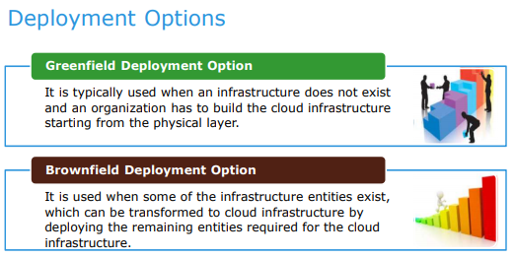

Slide 81
A greenfield deployment is the design, installation and configuration of computer infrastructure where none existed before, for example, in a new office. In contrast, a brownfield deployment is an upgrade or addition to existing infrastructure using legacy components.
Greenfield deployments are also called greenfield projects. They can be a computer network, website, software package, cloud software, telecom or data center installations that don't use previously developed infrastructure.
The terms greenfield and brownfield come from construction, with greenfield being new, undeveloped grassland and brownfield being land that is already built on.

Slide 82
When to consider greenfield deployment strategies
As an organization grows and matures, its need for computer resources increases. The rapid pace change in IT can also render legacy systems no longer cost-effective or obsolete. These forces make it beneficial for organizations to periodically examine their existing systems with an eye toward deploying new infrastructure with greenfield deployment opportunities.
A period of expansion, such as when expanding a factory or adding a data center, is a great time to consider the value of starting from scratch. The development and launch of a new product, the acquisition of another company and an overall digital transformation effort are also good opportunities to consider greenfield deployments.

Slide 83
Types of greenfield projects in IT
There are several different types of greenfield deployments. They include the following:
Greenfield IT facility. New building projects offer an opportunity for a greenfield approach to the IT infrastructure. Instead of relying on existing network and data center designs, the facility can be completely designed to support new technologies, such as fiber optics, modular data centers, and liquid or water-cooled server room design.
Greenfield website. As a website ages and its use grows, it becomes difficult to add new features and increase performance. Rebuilding it as a greenfield project without using any existing front-end or back-end code offers the best path forward. New technologies, such as containers, serverless computing and Jamstack, also offer improvements in performance, cost and maintainability.

Slide 84
Greenfield software development. There is value in occasionally reevaluating software projects and considering the possibility of redesigning them as greenfield projects. Rebuilding can enable new programming languages, continuous integration/continuous delivery, software design and efficiency improvements. In addition, it can make software easier to maintain and modify in the future.
Greenfield cloud expansion. New cloud computing technology offers opportunity for greenfield projects. Maintaining a hybrid IT infrastructure with both cloud and on-premises technology is often complex and difficult to maintain and troubleshoot. A greenfield cloud-first approach can provide stability and cut costs.
Greenfield network. New networking technologies give organizations the opportunity to replace legacy networks with entirely new systems. Instead of expanding legacy Ethernet or copper-based technology, they can invest in new technology stacks, like passive optical networks and fiber optic switching. New cellular radio technology, such as 5G New Radio, enables entirely new networks to be built. Greenfield projects are often used to build new cellular networks in developing countries where there is little or no legacy technology.

Slide 85
Advantages of greenfield deployments
There are several advantages to doing a greenfield deployment, including the following:
Purpose-built. Organizations can evaluate the project scope and requirements to meet the all needs of the project. They can then build custom solutions.
Future-proof. No legacy technology means modern technology can be used for greater compatibility.
Right-sized scaling. Project designs consider size and performance requirements, with future scaling needs built in.
Lower maintenance. Project designs can use standards-based approaches that cut down on maintenance needs, require less institutional knowledge and enable greater employee flexibility.
Less dependencies. Once old, outdated systems and designs are gone, new systems can be designed with greater fault tolerance.

Slide 86
Disadvantages of greenfield projects
Greenfield deployments aren't without their challenges. The following ones are among them:
Slower project startup. Exploring new options and deciding which to pursue takes time; these projects are often slow in the early stages.
Higher startup costs. New design and technology can lead to longer projects and higher costs, especially during early project phases. These are often made up for during operation through better return on investment.
New skill requirements. IT staff that implement these systems may need to learn new skills. This takes time as employees learn to work a new system.
New knowledge requirements. Adapting new technology often means training existing employees, bringing in new people or hiring consultants.

Slide 87
Brownfield software development refers to the development and deployment of a new software system in the presence of existing or legacy software systems. Brownfield application development usually happens when you want to develop or improve upon an existing application, and compels you to work with previously created code.
Therefore, any new software architecture must consider and coexist with systems already in place – so as to enhance existing functionality or capability. Examples of Brownfield development include: adding a new module to an existing enterprise system, integrating a new feature to software that was developed earlier, or upgrading code to enhance the functionality of an app.

Slide 88
The Advantages of Brownfield Software Development
Some of the largest advantages of Brownfield development include:
Offers a place to start with a predetermined direction
Gives a chance to add improvements to existing technology solutions
Supports working with defined business processes and technology solutions
Allows existing code to be reused to add new features
The Disadvantages of Brownfield Software Development
Brownfield projects do also have their own set of disadvantages. These include:
Requires thorough knowledge of existing systems, services, and data on which the new system needs to be built
There may be a need to re-engineer a large portion of the existing complex environment so that they make operational sense to the new business requirement
Requires detailed and precise understanding of the constraints of the existing business and IT, so the new project does not fail
Dealing with legacy code can not only slow down the development process but also add to overall development costs

Slide 89
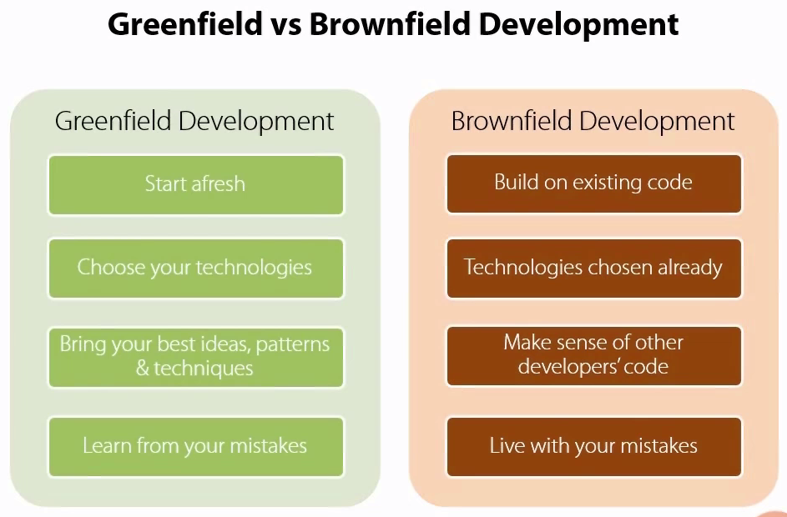

Slide 90
The Greenfield and Brownfield Deployment Options
Most of the companies moving to the cloud platform either choose to get rid of
(or scrap)their existing on premise infrastructure and choose cloud or combine on
premise and cloud defining such a process by which both are optimally utilized.
Before building a cloud infrastructure, organizations must identify which deployment option
is appropriate for them. There are two deployment options for building a cloud infrastructure
Greenfield deployment option and
Brownfield deployment option.
Greenfield means deploying completely new infrastructure from scratch , the entire
process of designing, developing, deploying, monitoring and management is involved.
The Brownfield is making changes in the existing infrastructure, a brownfield deployment
option is used when some of the infrastructure entities exist, which can be transformed to a
cloud infrastructure by deploying the remaining entities required for the cloud infrastructure.

